Slide 1
COMP 1800
Week 1 - Wednesday

Slide 2
Last time
What did we talk about last time?
Syllabus
Problem solving

Slide 3
Questions?

Slide 4
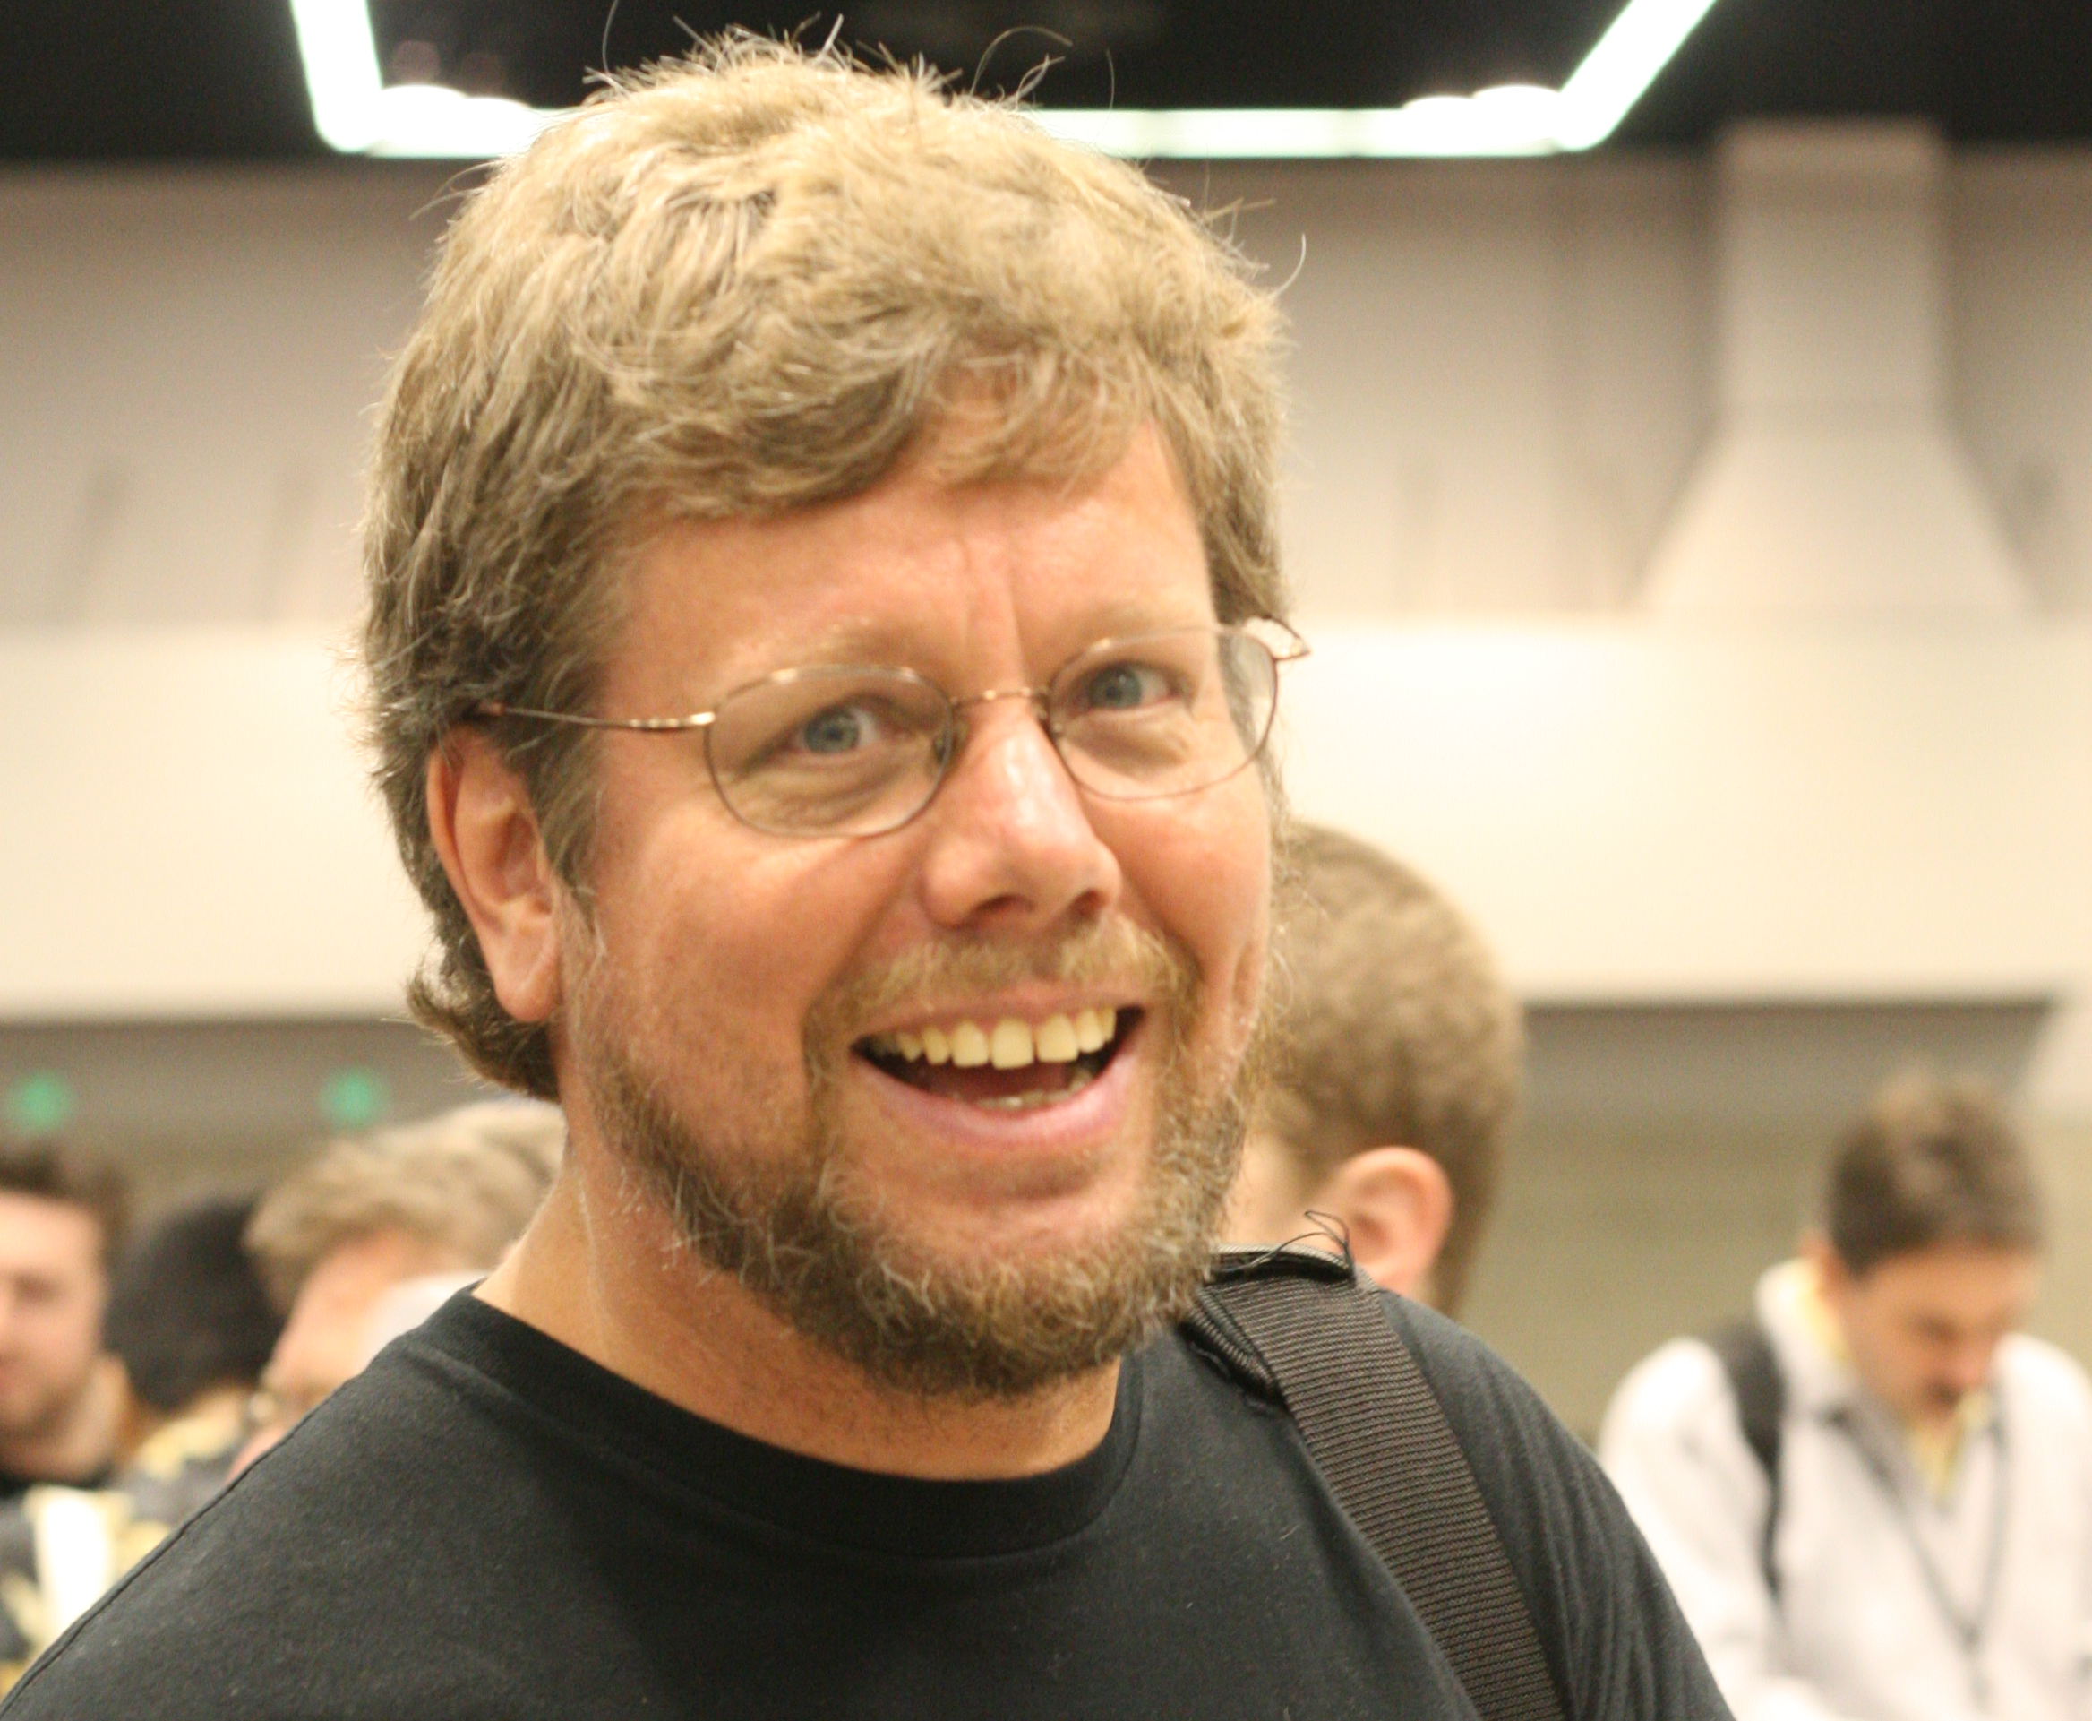
About Python
Developed by Guido van Rossum, beginning in 1989 in the Netherlands
Named after Monty Python's Flying Circus
First version was released in 1991 (v0.90)
Object-oriented
Version 1.0: 1994
Functional programming
Version 2.0: 2000
List comprehensions and garbage collection
Version 3.0: 2008
Fixed fundamental language design flaws
Guido van Rossum, 2006 "Benevolent dictator for life" until 2018

Slide 5
What is an object?
In Python, everything is an object
But what is an object?!
Four properties:
Identity: Similar to a name
State: Values inside
Type: Classification of the object
Behavior: Stuff an object can do with its state, called methods

Slide 6
Programs
According to the object-oriented perspective, a program is a specification of objects and how they interact
Another way of looking at a program is a sequence of characters (Unicode, ASCII, other) that follow certain rules of structure

Slide 7
Linguistics
English is composed of sentences made up of words that follow a certain grammar
<subject> <predicate>
Python is composed of programs made up of tokens that follow a certain grammar
There are five kinds of tokens in most programming languages

Slide 8
Tokens
Literals
Values from some built-in type
Identifiers
Names used for things
Keywords
Identifiers with special meaning
Operators
Computational actions
Separators
Punctuation
White space also plays a role, as do comments

Slide 9
Examples with IDLE

Slide 10
IDLE
I will use IDLE for all examples in class
There are other Python IDEs, some with more power, but IDLE comes with Python
You can use IDLE interactively
Every line you type in is executed
Called a read-eval-print loop (or REPL)
You can also have IDLE run a file that was written earlier
This is how you will turn in most of your assignments
Both ways of running IDLE are useful

Slide 11
Literals
Each type has a number of literals associated with it
A literal is a concrete value within a given type
Literals for the integer type are numbers exactly like what you would expect:
115
-9837461
2

Slide 12
Let's start by using IDLE as a REPL
We can type literals and operations and see what the results are
>>> 5
5
>>> 4 - 10
-6

Slide 13
Variables
It is also possible to create variables for each data type
Think of a variable as a "box" that you can put values into
The name of a variable is an identifier
The type of a variable is whatever you've most recently put into it
The following creates a variable called i that currently holds an integer
Then, we multiply i by 3
>>> i = 42
>>> 3 * i
126

Slide 14
Changing the value of a variable
Python variables are not like variables in math which have a fixed (but unknown) value
Instead, a Python variable can be changed by a line of code
We use the assignment operator (=) to change the value of a variable as follows:
The first time, 3 * i is 126, but the second time, it's 15
>>> i = 42
>>> 3 * i
126
>>> i = 5
>>> 3 * i
15

Slide 15
Variable names
Mathematicians often use really short variable names like x or y
In Python, the variable names can be longer
Choose name that are descriptive
Variables have to start with a letter (or an underscore) and then can have letters, underscores, or numbers
Spaces aren't allowed in a variable name
The book uses camel-case
To make it more readable, each word in a multi-word variable name is capitalized
>>> rainfall = 2.61
>>> top10 = 21
>>> 5fingers = 19
>>> first number = 42
Legal
Illegal
>>> awesomeVariable = 15

Slide 16
Operators
Python has a number of operators that work with integers and floating-point (decimal) numbers
Operator | Operation | Example | Result
+ | Add | 5 + 7 | 12
- | Subtract | 5 - 7 | -2
* | Multiply | 5 * 7 | 35
// | Integer division (round down) | 5 // 7 | 0
/ | Regular division | 5 / 7 | 0.7142857142857143
% | Modulo (remainder) | 5 % 7 | 5
** | Exponentiation | 5 ** 7 | 78125

Slide 17
Order of operations
You can do complicated expressions
Just like math, there's an order of operations that determines which operations happen first
Operator | Operation | Evaluation Order
() | Parentheses | Left to right
** | Exponentiation | Right to left
* // / % | Multiplication and division | Left to right
+ - | Addition and subtraction | Left to right
>>> 3 * (4 + 2) / 8
2.25

Slide 18
Floating-point numbers
You'll use integers often in programming
They're surprisingly versatile!
Sometimes, however, you need to represent numbers with a fractional part
Such numbers are called floating-point numbers in computer science, because they store a representation of a number with a floating (moving) decimal point
Integers in Python are exact, but floating-point numbers are approximate
You can write them normally or in scientific notation where a number after e means multiplied by 10 raised to that number
>>> 3.14159
3.14159
>>> 1.75e7
17500000.0

Slide 19
Converting between integers and floating-point
In math, there's no difference between 3 and 3.0
In Python, the difference is there, but it's subtle
You can convert between the integers and floating-point variables using the following functions
Function | Description | Example | Result
float(number) | Convert to floating-point | float(15) | 15.0
int(value) | Convert to integer, dropping fractional part | int(2.7) | 2
round(value) | Round to the nearest integer | round(2.7) | 3

Slide 20
A Few Python Details

Slide 21
Output
Basic output is done with print()
Put what you want to print inside the parentheses
You can print:
Any text enclosed in single or double quotes:
print('43 eggplants')
Any integer:
print(43)
Any floating-point number:
print(23.984)
Even complex numbers:
print(5 + 7j)
If you want multiple things to go on the same line, you can use print() with more than one argument:
print(99, 'red', 'balloons')
By default, they will be printed with a space between each one

Slide 22
Sequencing
Instead of one print statement, we can have several:
Each statement is an instruction to the computer
They are printed in order, one by one
print('Hello, world!')
print('Hello, galaxy!')
print('Goodbye, world!')

Slide 23
Case Sensitivity
Python is a case sensitive language
Print is not the same as print
print('Word!') prints correctly
Print('Word!') causes an error

Slide 24
Whitespace
Python doesn't care about whitespace within a line of code
is the same as:
However, whitespace at the beginning of a line of code matters!
The following will cause an error:
Indentation is important in Python, so don't indent without reason!
print('Hello, world!')
print ( 'Hello, world!' )
print('Hello, world!')

Slide 25
Comments
Programs can be confusing
Sometimes you want to leave notes for yourself or anyone else who is reading your code
The standard way to do this is by using comments
Although comments appear in the code, they do not affect the final program

Slide 26
Comments
Single line comments use #
Everything after the # is a comment and doesn't affect the execution of the program
Sometimes, you want to comment out a section of code to see what happens if it doesn't run
To do that in Python, put triple apostrophe (''') on a line by itself before the code and another after
print('Hi!') # this is a comment
'''
print('Hi!')
print('Bye!)
print('No one will see this!')
'''

Slide 27
Turtle

Slide 28
Turtle
Turtle is a tool that lets us draw simple pictures in Python
To use Turtle, we first have to import the turtle library
Then, we have to create a turtle
I name mine yertle, but you can name it any legal variable
Don't worry too much about this syntax
>>> import turtle
>>> yertle = turtle.Turtle()

Slide 29
Methods
A turtle object has methods
Methods let us tell the turtle to do things or ask it questions
To call a method, you say the name of the turtle (yertle, in my case), you put a dot, then you put the name of the method you want, then parentheses, and sometimes information between the parentheses
The extra information are called parameters
For example, to make yertle move forward 100 steps, type:
>>> yertle.forward(100)

Slide 30
Turtle methods
The book has a much longer list, but here are a few useful turtle methods
Method | Parameter | Description
forward | Distance | Move forward
backward | Distance | Move backward
left | Angle | Turn counter-clockwise
right | Angle | Turn clockwise
up | None | Pick up the turtle's tail (to stop drawing)
down | None | Put down the turtle's tail (to draw again)
heading | None | Return the angle the turtle is pointing
position | None | Return the position of the turtle

Slide 31
Turtle practice
Get the turtle to draw a square whose center is the center of the drawing space

Slide 32
Upcoming

Slide 33
Next time…
Functions
for loops
Then, a work day for the first assignment

Slide 34
Reminders
Review Chapter 1 of the textbook
Come to class ready to program in IDLE

